Slide 1


DISHCOVERY
D I S C O V E R I N G I N S I G H T S

Slide 2


OUR TEAM MEMBERS
Jaspreet kaur chahal
Rashi Shivhare
Garima
Rai
(30122361)
(30122348)
(30122331)
RIMI
MAZUMDER
MANAS YADAV
Rachana
KUlthe
(30122353)
(30122347)
(30122349)

Slide 3
INTRODUCTION
A Power BI–driven analytics project that highlights key restaurant metrics, including sales performance, customer behavior, and menu efficiency. The dashboard delivers clear, actionable insights to support smarter decision-making and operational growth.

Slide 4



AGENDA
overview
methodology
insights
Dishcovery uncovers key patterns in restaurant performance.
Data cleaned, modeled and analyzed in Power BI.
Reveals retention gaps, category dips and menu risks.

Slide 5
overview
To analyze operational data from the restaurant chain to identify key revenue drivers, operational inefficiencies and customer behavioral patterns.
Key Business Questions
What drives peak Sales?
Which menu items are underperforming?
How does location impact revenue?

Slide 6




Methodology
Data Cleaning
Data Modelling
Removed duplicates, handled nulls and standerized data formats using power query
Created a star schema connecting fact tables to dimension tables.
Visualization
Measure Calculations
Designed interactive dashboards.
Defined DAX Measure.

Slide 7


Tools Utilised
Excel
Power BI
Data cleaning and initial validation.
Data modelling and dashboarding.

Slide 8



Key insights
Sales and operations
Products and customers
Outlet performance
Demand patterns
Revenue growth
Staff efficiency
Customer behavior
Menu trends

Slide 9




Dataset Summary
items
Outlets
Menu hierarchy(category, sub-category,pricing and cost.
Location details and operational age.
Customers
Sales
Demographics, frequency and ratings.
Transactional-level data, quantities and order totals.

Slide 10
Data Warehouse
DimMenu
Item_id
category
cost
Item_name
price
profit_margin
sub_category
DimCustomers
Cust_id
age
Age group
contact
Name
Rating
FaCtSales
cust_id
Item_id
outlet_id
sale_date
staff_id
count
cost_amount
gross_amount
price
DimStaff
DimOutlets
staff_id
contribution
name
Outlet_id
role
outlet_id
area_code
city
Location_name
sales
state

Slide 11
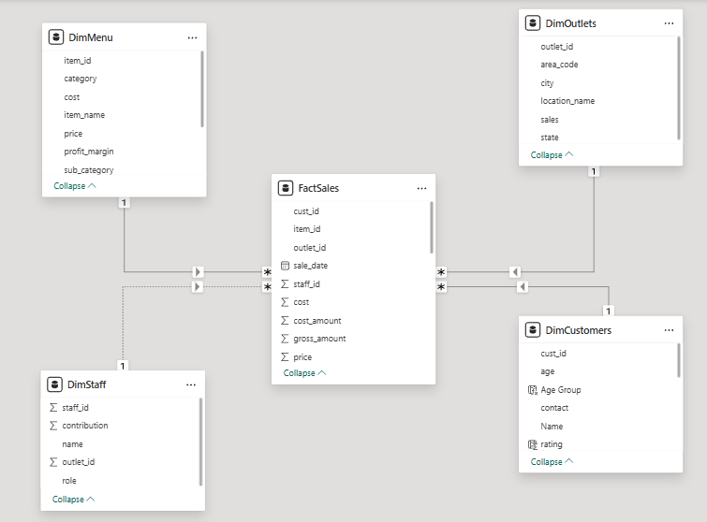

Slide 12
Dashboard
01

Slide 13
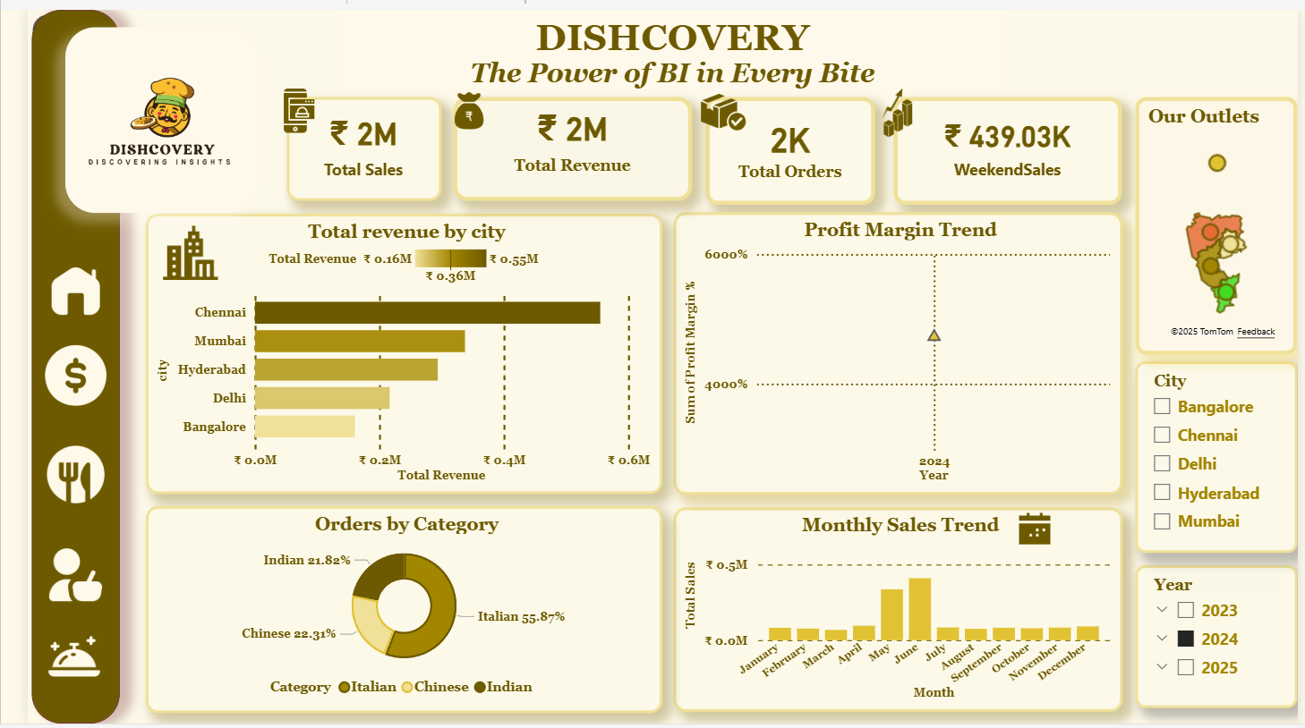

Slide 14
Sales
02

Slide 15
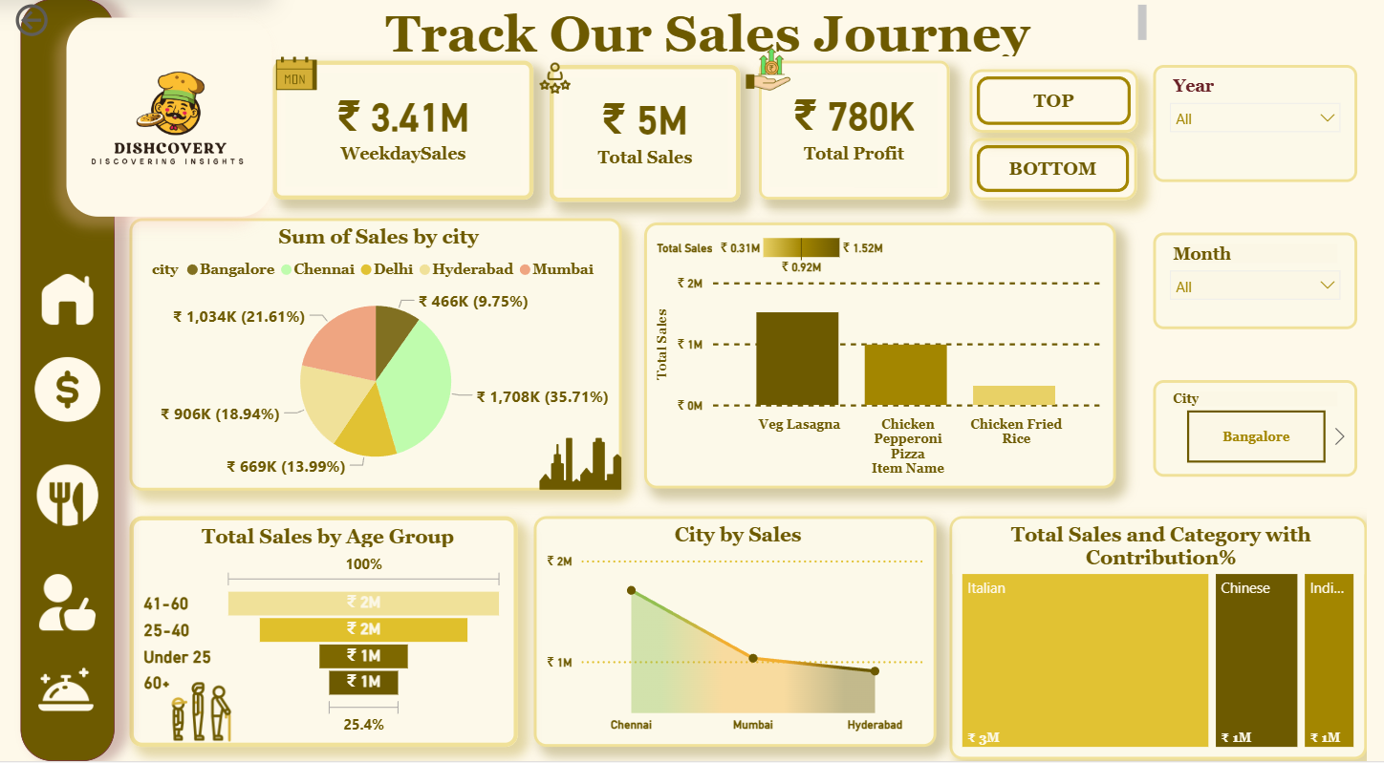

Slide 16
orders
03

Slide 17
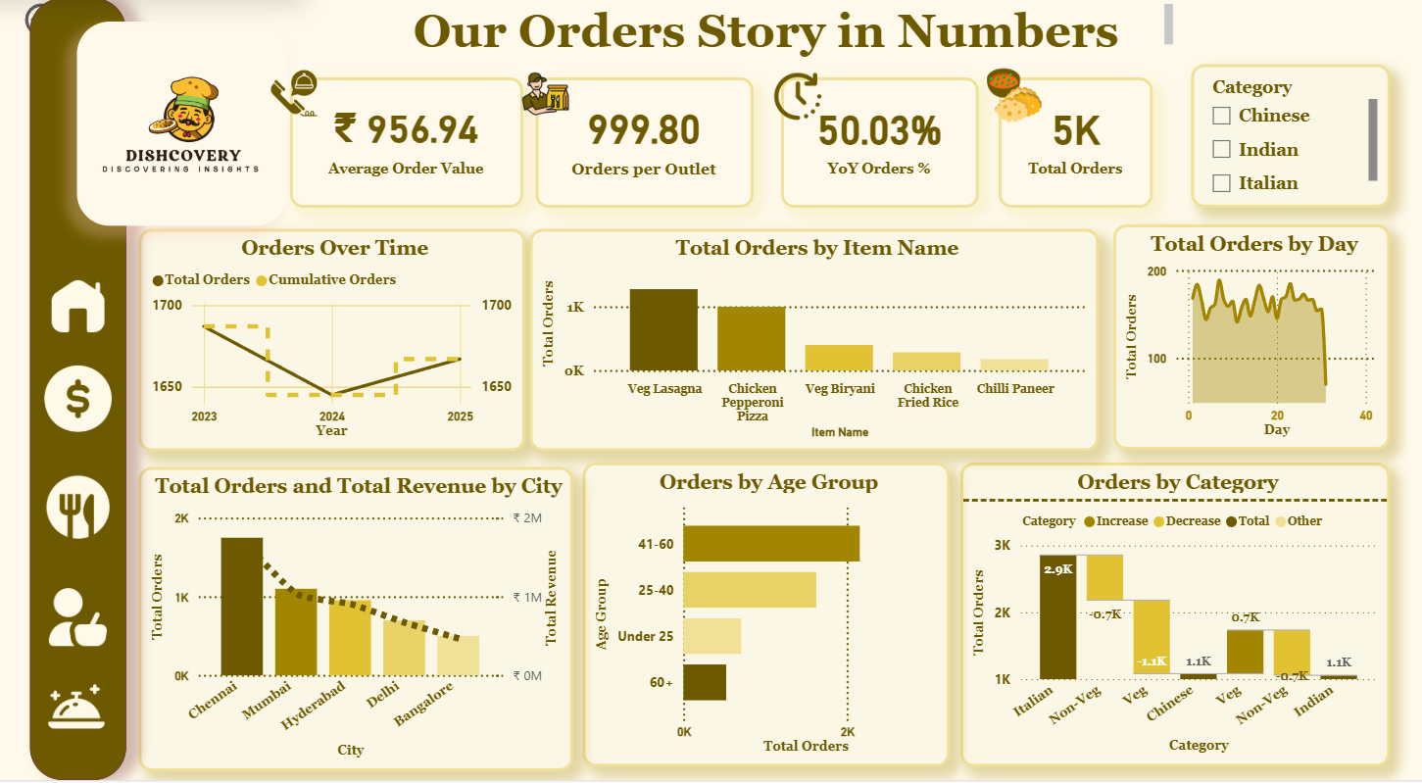

Slide 18
customers
04

Slide 19
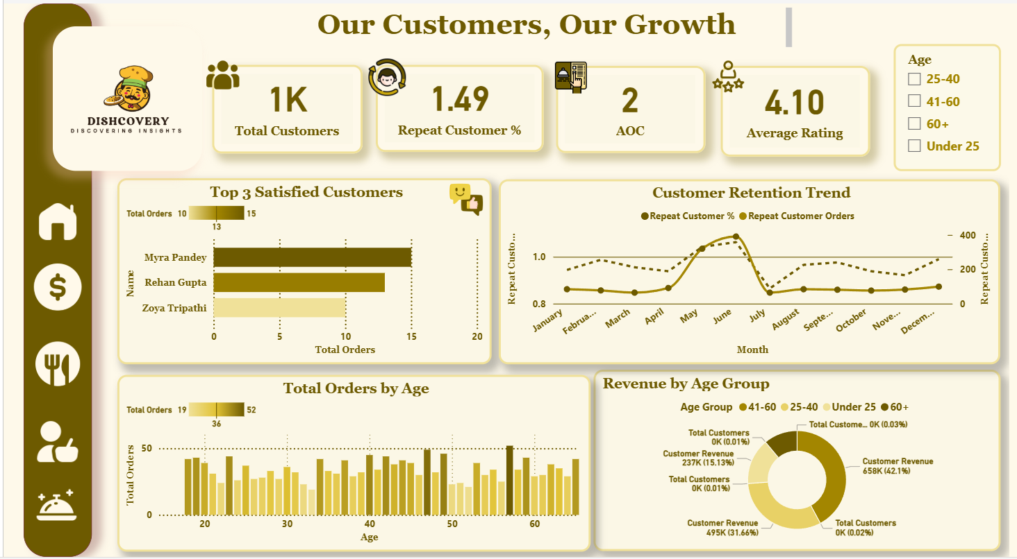

Slide 20
Menu
05

Slide 21
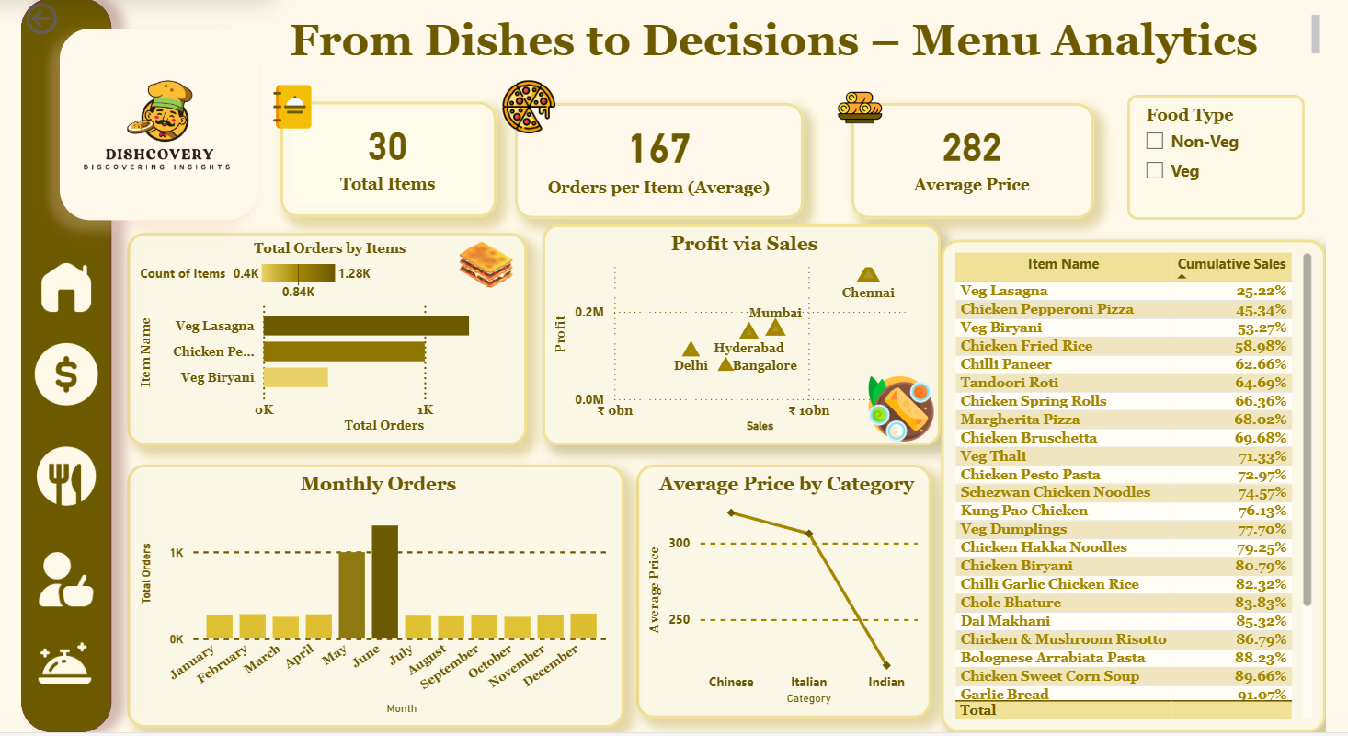

Slide 22
Conclusion
Transformed raw operational data into actionable insights.
Cleaned and standardized datasets for accuracy.
Modelled data using a star schema for efficient analysis.
Calculated key metrics like revenue growth, average order value, and customer retention using DAX.
Designed interactive Power BI dashboards to visualize sales trends, customer behaviour, and menu performance.
Enabled clear, data-driven decision-making and turned data into a strategic asset.

Slide 23
¡tHANKYOU!

